Slide 1
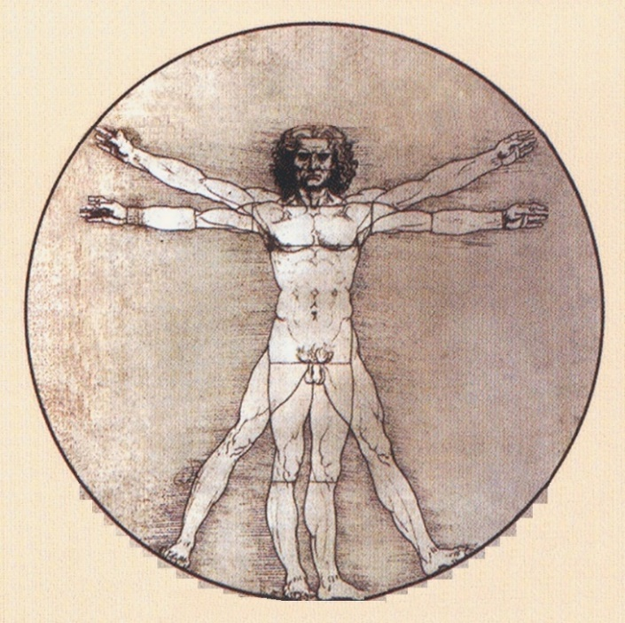
Hello, dear Thinkers about SYSTEMIC Thinking!
We have started 3rd part of our study course «Systems theories in practice» with general topic «UNIVERSE as the SYSTEM» as a short summary of the 1st half of the course.
Let's continue to study connections of the general systems theory with our Life in practice!
HUMAN –
conscious alive being
as a part of the Universe –
subsystem of the Universe
as the SYSTEM
Next topic «HUMAN as the SYSTEM»
Study week No 9

Slide 2
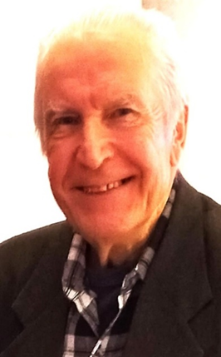
University of Latvia
Prof. emeritus
ANDRIS BROKS
Elective study course
«SYSTEMOLOGY
OF THINKING»
andris.broks@lu.lv https://blogi.lu.lv/broks/
ST(2)23-24 Academic year 2023-2024 2nd semester
Study week No9 : HUMAN as the SYSTEM
(HUMAN - phenomenon within the UNIVERSE as changimg Thing - SYSTEM)
12.04.24 – 19.04.24

Slide 3
Structure of our study course «Systemology of Thinking»
1st part
3rd part
WORLD OF THOUGHTS
3rd chapter -–
Arrangement of the World of Thoughts
2nd chapter--
Transmission of Thoughts
1st chapter
Thoughts and Thinking
2nd part
SYSTEMS THEORIES
IN PRACICE
1st chapter – UNIVERSE as the SYSTEM
2nd chapter Human,
Life, Society as SYSTEMS. Systemologies of
State, Research, Education.
3rd chapter Global Life
as SYSTEM
SYSTEMIC THINKING
(general and particular systems theories)
1st chapter-
SYSTEMS,
general properties
of systems
2nd chapter-
CONSTRUCTION of systems,
HIERARCHY OF SYSTEMS STRUCTURES
3rd chapter-
CHANGE
of systems properties,
PROCESSUAL SYSTEMS
Study COURSE is realized in practice
as a processual SYSTEM –
in space (content) and time (process)
INTRODUCTION CONCLUSION

Slide 4
Let’s start
our distance meeting -
stage No1
Let’s start with traditional remarks on basic concepts that were considered during the previous study weeks.

Slide 5
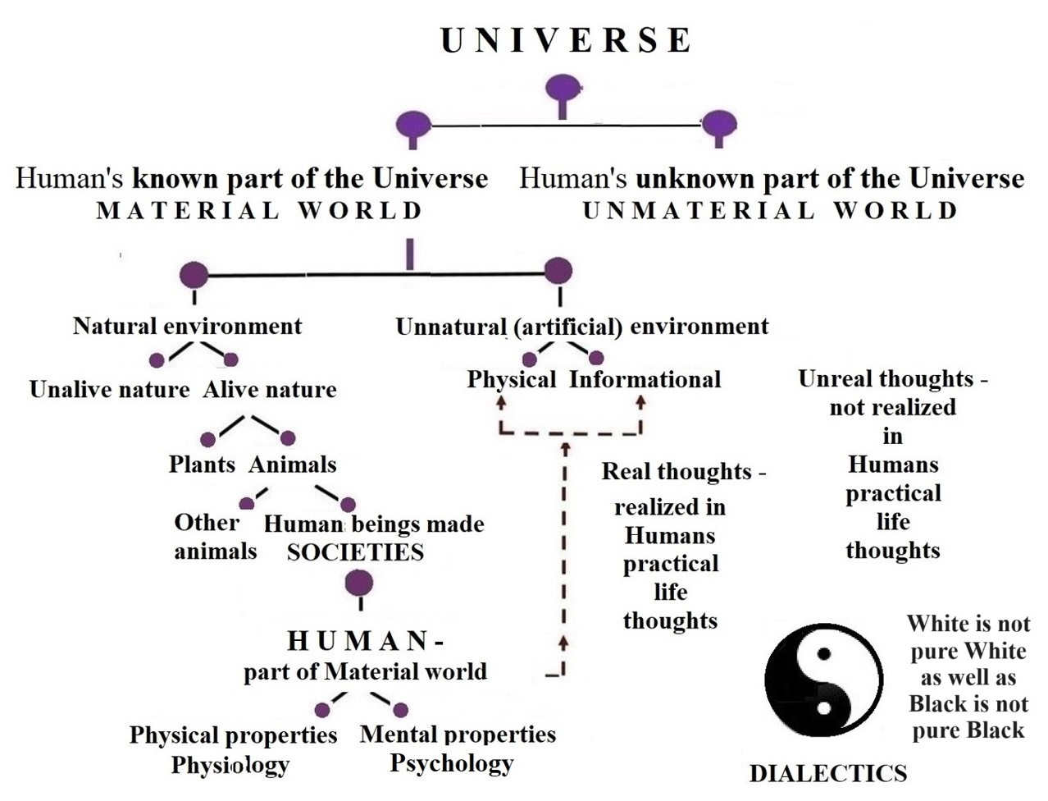
General structure
of the UNIVERSE
UNIVERSE - it is a set
of diverse Phenomena
as Changing Things.
LIFE - it is a set of diverse humans’ activities to satisfy their needs of Life.
It’s continous everyday meeting with something known and unknown!
HUMAN as Homo
Sapiens – it is the conscious alive (living) being.

Slide 6
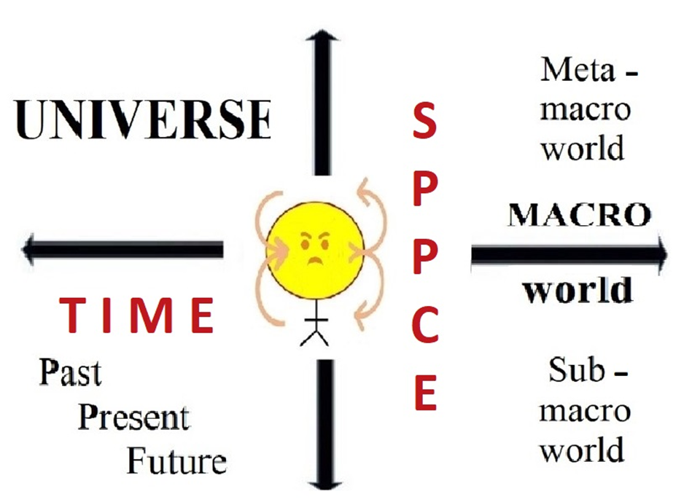
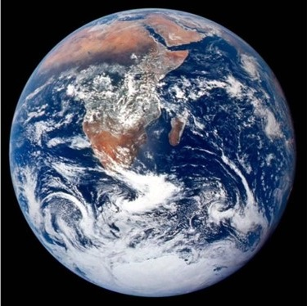
All phenomena of the Universe are represented
in the World of Human’s Thoughts as changing things,
that are interconnected and interacting in Space and Time
SPACE-TIME
CROSS –
the most important
dialectical
Thoughts structure
Me as a HUMAN - part of the Universe: here (in space) and now (in time)

Slide 7
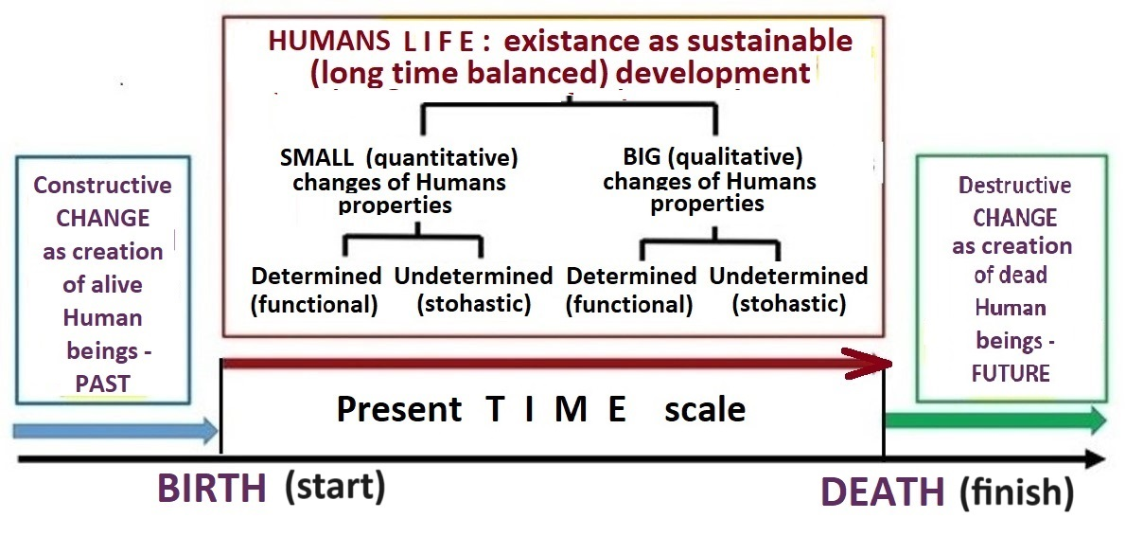
EXISTANCE of the HUMANITY on the planet EARTH –
sustainable (long time balanced) development of Humans LIFE

Slide 8
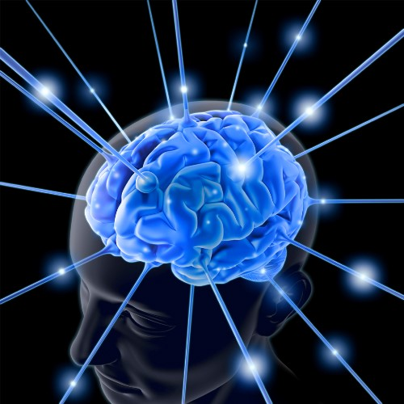
Humans perceive and describe the UNIVERSE
(as a diverse set of phenomena as changing things)
in PARTS, comparing them with each other
and connecting them into the WHOLE as the SYSTEM.
Observed in practice
cause-and-effect chain
relationships of the phenomena within the Universr are explained
as INTERACTION of all Things – phenomena of
the Universe.

Slide 9
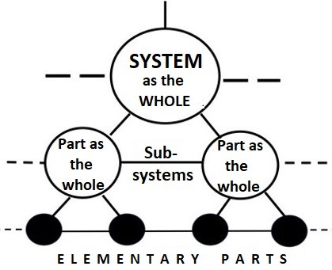
General orTop concepts of all SYSTEMS THEORIES
Word SYSTEM means everything as the WHOLE, what conteins interactive parts and at the same time is the PART as subsystem of some other bigger System
Arranged or systemic representation of the Universe is realized by PARTS (ANALYSIS), comparing and connecting them (SYNTHESIS) within the WHOLE (SYSTEM).
HIERARCHY of systems structures

Slide 10
SYSTEMIC thinking – it means human’s THINKING
as arranging or systemic representation of the Universe
within the Human’s WORLD OF THOUGHTS
Systems theory as
GENERAL SYSTEMS THEORY
Is the top level theory above all particular or applied systems theories
SYSTEMOLOGY is particular or applied systems theory about ARRANGEMENT of human’s SELECTED PHENOMENA OF THE UNIVERSE
SYSTEMS THEORY
systemologies

Slide 11
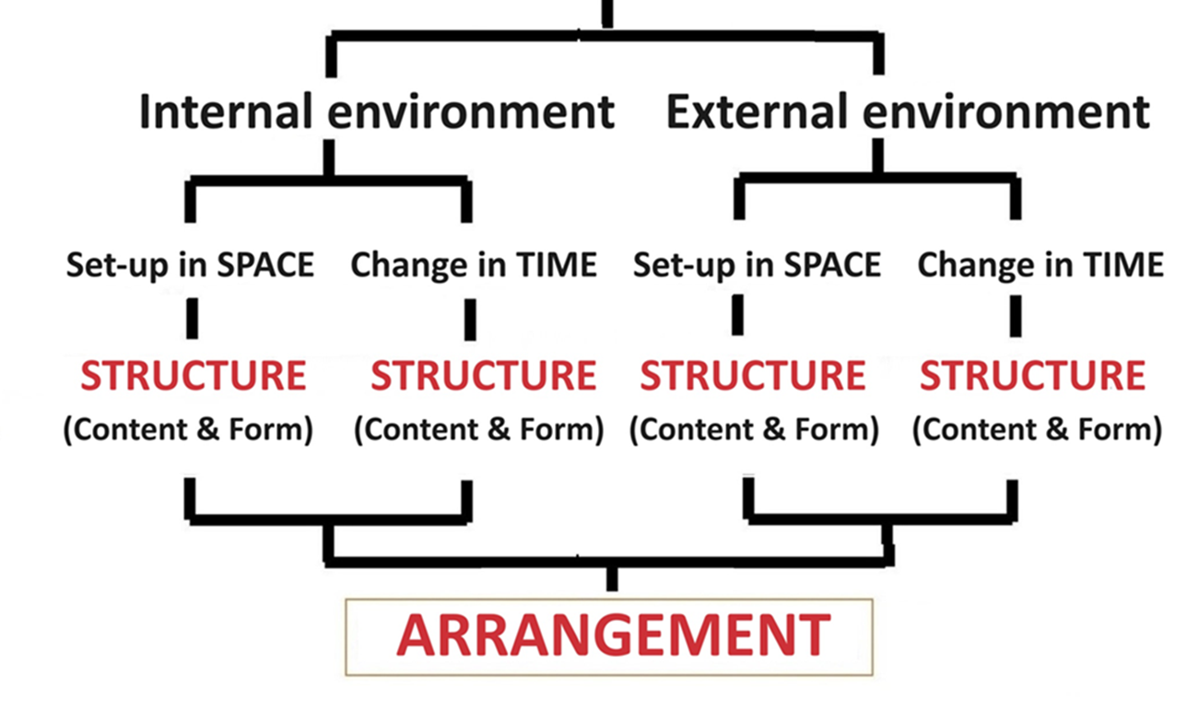
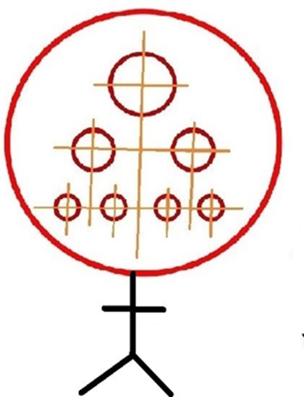
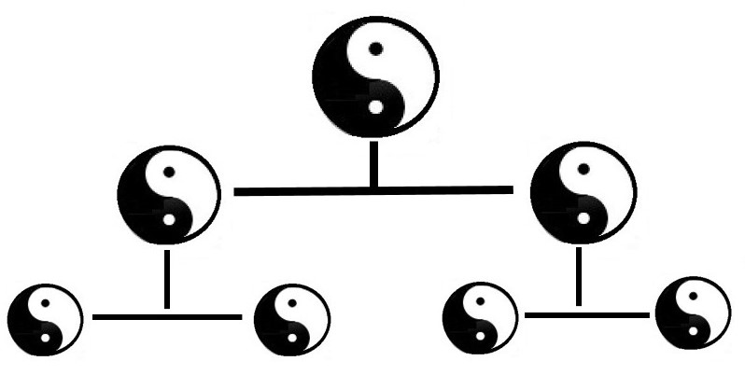
GENERAL (universal for all systems)
properties of every THING as the SYSTEM
(Every THING is the WHOLE as the SYSTEM, what is made by PARTS and at the same time is the PART of other – bigger THING as the WHOLE – bigger SYSTEM)

Slide 12
U N I V E R S E as the S Y S T E M
All phenomena
of the Universe – every thing as a changing thing in space and time
i n t e r a c t s
with every
other
Thing else.

Slide 13
I n t e r a c t i o n of everything within the Universe
is one of the top level concepts of all systems theories
The process of interaction of things means mutual action (influence) and reaction (counterinfluence) of things. Mutual actions and reactions of interacting things are represented within the Human's World of Thoughts
as PROCESSUAL SYSTEMS.
Observing things in practice, it is found that the reaction (effect) lags behind the cause in time. Modern theories today succesfully explain this very important for practice effect-and-cause chain relationship.
FORCE, WORK, ENERGY, POWER
as well as Statics and Kinetics, Dynamics and Energetics, transformation, transmission and storing of energy today are well developed general concepts for practice.

Slide 14
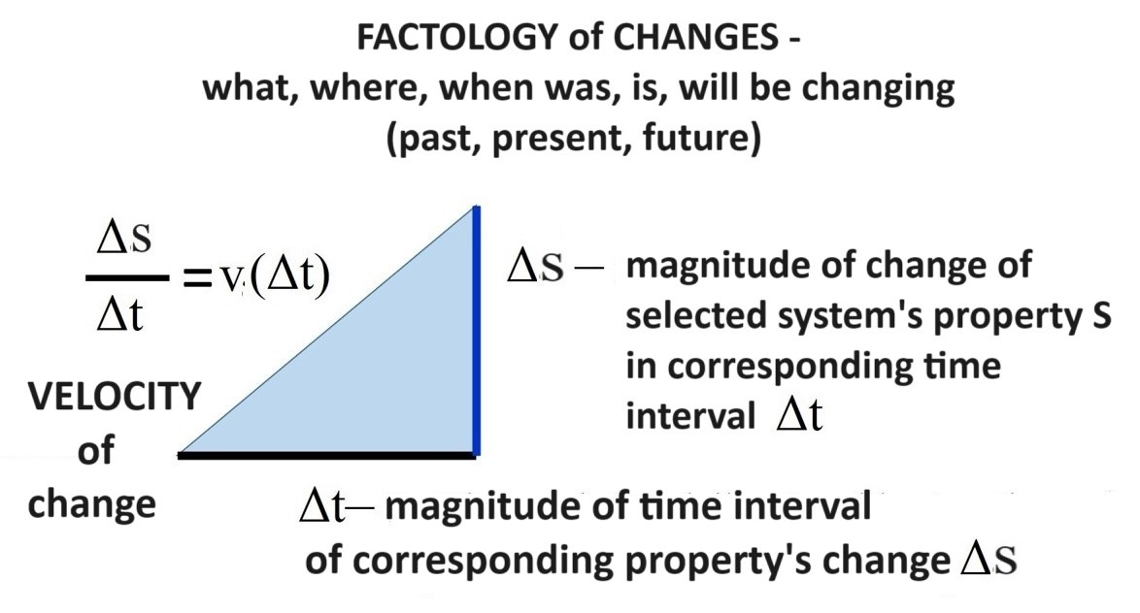
Understanding and comprehension of every
CHANGE OF SYSTEMS properties as a causal process of
i n t e r a c t i o n
of systems
is based on the concept which is denoted by the word VELOCITY and interconnects the both fundamental concepts of SPACE and TIME .
Changes of velocity
are because of active summary FORCE of interaction

Slide 15
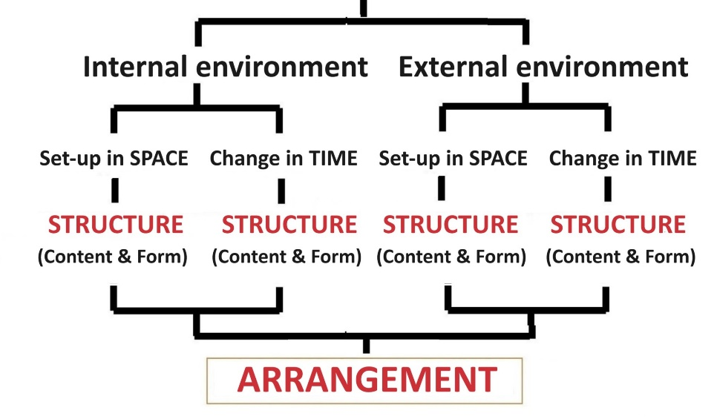
During the study 2nd chapter of the 3rd part
of the course, we will causally consider
three Great Thoughts about Human’s Life in Society
HUMAN LIFE SOCIETY
Week no 9 Week No10 Week No 11
Cause Effect - Cause Effect

Slide 16
Let’s continue
our distance meeting -
stage No2
Now it is last time to send QUESTIONS
for interactive SEMINAR,
what follows just after this
LECTURE

Slide 17
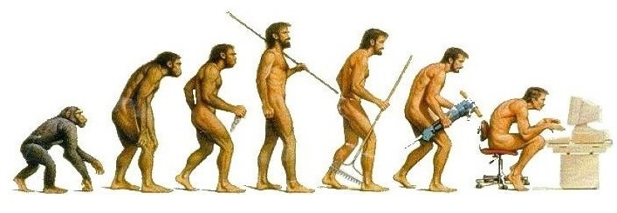
What are your QUESTIONS, SUGGESTIONS?
Please write them in the "chat" section of computer-based communication - we will discuss them after the lecture!

Slide 18
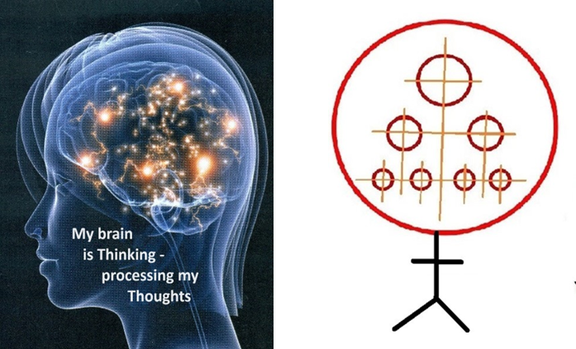
We have started 3rd part of our study course
"SYSTEMOLOGY OF THINKING« as well as of corresponding
reseach project «SYSTEMIC THINKING»
We are thinking Big Thoughts about Human’s LIFE!
My question to everybody of you is:
what do you think about yourself and your LIFE within the Universe, when studying at the University?

Slide 19
Let’s continue
our distance meeting -
stage No3
2nd chapter of the 3rd part
of the study course:
HUMAN as the SYSTEM
(subsystem of the Universe)

Slide 20
Let’s start systemic consideration
of three phenomena of the Universe
what are especially actual for us in practice.
HUMAN LIFE SOCIETY
as the SYSTEM as the SYSTEM as the SYSTEM
Week no 9 Week No10 Week No 11

Slide 21
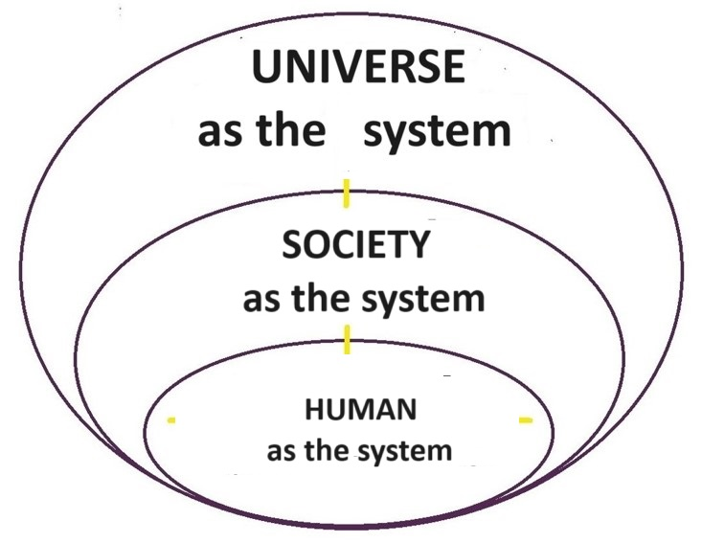
HUMAN as the system fit into the total hierarchical structure of the Universe as the system
Every HUMAN as the WHOLE is PART of the UNIVERSE!
I am a part of the Universe : here in SPACE and now in TIME.

Slide 22
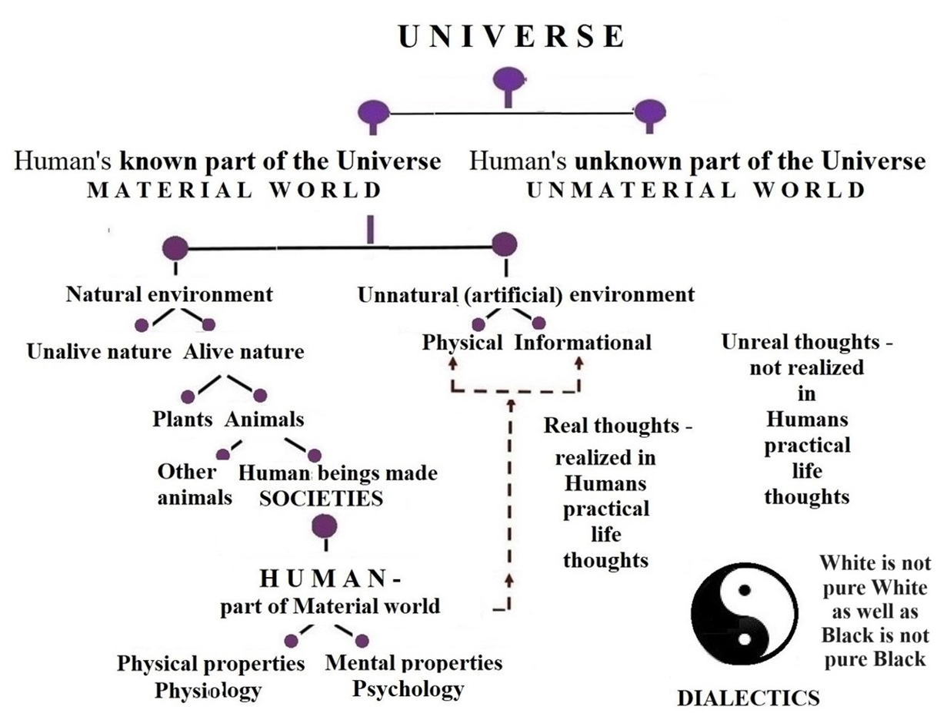
HUMAN – conscious alive being, what is a part of the Universe – subsystem of the Universe as the SYSTEM

Slide 23
What does it mean «human is alive being?
Each living person is characterized by the coexistence of four processes - internal and external circulation on substance and information.
Diverse circulations | Substance | Information
Internal | * | *
External | * | *
Such full scale characteristic means
that corresponding human being is alive.

Slide 24
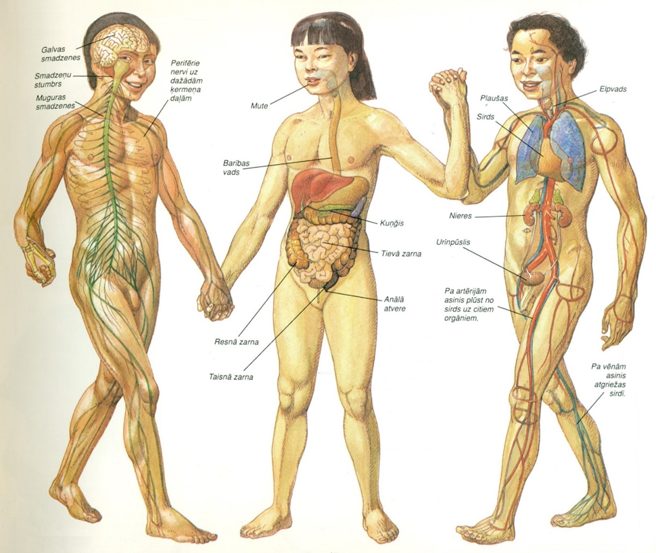
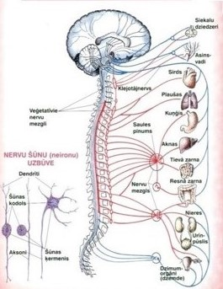
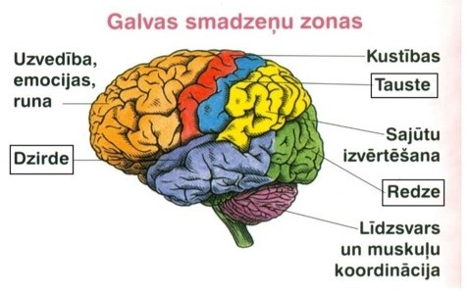
Modern HUMAN is highly developed alive being – HOMO SAPIENS – it is the conscious living being
Physiology Nervous system-neurology Psychology

Slide 25
WORLD of THOUGTS –
REPRESENTATION of reflected phenomena of the UNIVERSE
THOUGHTS – representations of reflected phenomena of the UNIVERSE, what are embodied in the human’s brain concepts and images, which are characterized by the corresponding words.
THINKING – it’s arranged processing – arranging of all thoughts within human’s brain, what ensures the management and execution of more or less consciously organized human’s life activities.

Slide 26
T H I N K I N G - creation and processing of THOUGHTS
CONSIDERATION
The external
TRANSMISSION
of thoughts
and the
REALIZATION
of real thoughts
in practice
* description of sensations
* coding of sensations (signs)
* sensing (seeing, hiearing, touching)
SENSES
(communication
and observation)
COGNITION A C T I O N
M a t e r i a l w o r l d – known to Human part of the Universe - – Human’s real living environment

Slide 28
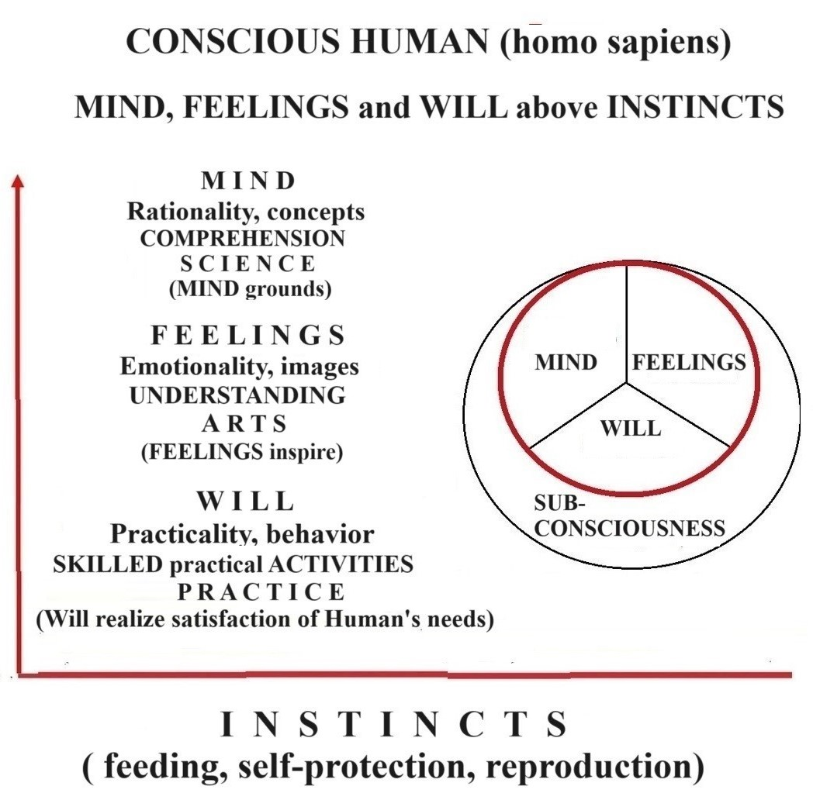
HUMAN’S I N T E L I G E N C E
EMOTIONAL INTELLIGENCE is one of the characteristics of human’s consciousness (spirituality, mentality)), which is related to a person's emotionally imaginative world of feelings. However, the emotional manifestation of feelings is only one part of the human’s consciousnessy in the real practice of our life.
RATIONAL INTELLIGENCE is the top part of human’s consciousness that complements emotional intelligence. Rationality ensures the purposeful realization of created by the human’s mind scientific knowledge.
Finally, the third part of spirituality exists at the level of human consciousness. It is the WILL (willpover) without which the human’s INTELLIGENCE does not create comccious human’s life as the whole.

Slide 29
Human’s LIFE wihin the Universe
in space and time – processual system
Human’s LIFE | Physical LIFE (physiology) |  | Mental or psychic or spiritual LIFE (psychology).
External environment | s(t) Step by step | s(t) Step by step | s(t) Step by step | s(t) Step by step
Internal environment | s(t) Step by step | s(t) Step by step | s(t) Step by step | s(t) Step by step
 | SPACE (s) | TIME (t) | SPACE (s) | TIME (t)

Slide 30
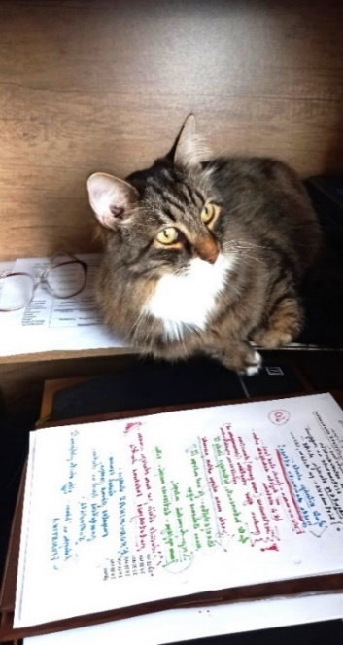
Let me wish
to all of you successful independently creative study week No 9
Materials for study week No9 09_ST(2)23-24 engl 12.04.24
are here: https://failiem.lv/u/yy3gbvk2yk
See you again on next Friday, 19.04.24 afternoon (16:30 –18:30)
We continue to study the interconnections between general systems theory and our practical life!
Next topic will be : Human’s LIFE as the SYSTEM.

