Slide 1
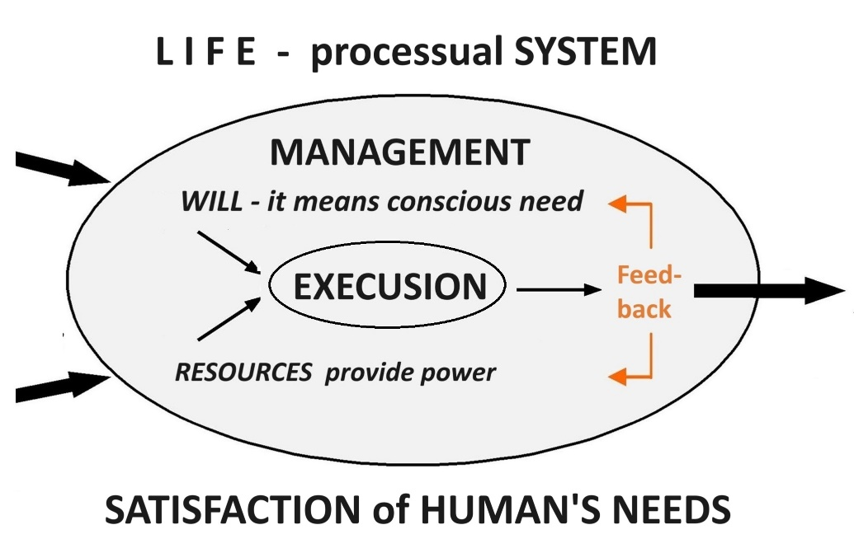
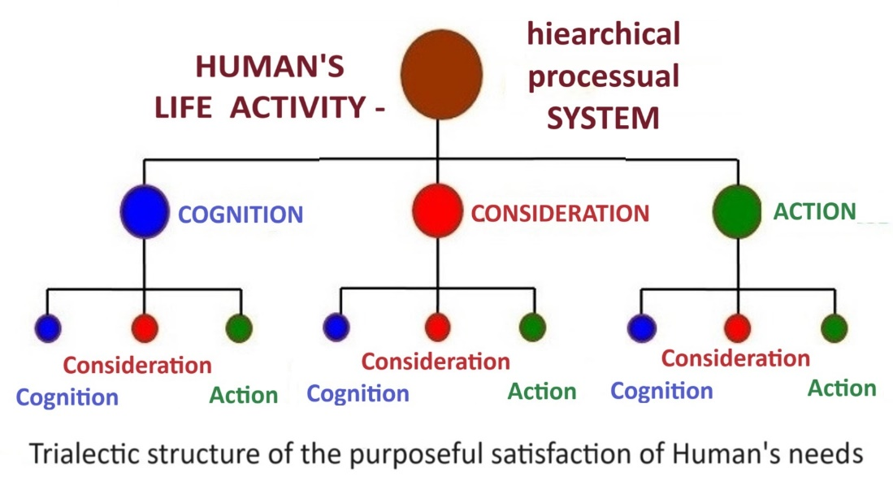
Hello, dear Thinkers about SYSTEMIC Thinking!
We are continuing 3rd part «Systems theories in practice» of our study course what is devoted to study connections of the general systems theory with our Life phenomena in practice!
Study week No 10
«Human’s LIFE as the SYSTEM»
Systemic Thinking manages
Human’s conscious Life

Slide 2
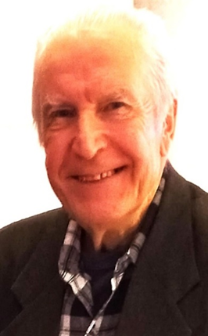
University of Latvia
Prof. emeritus
ANDRIS BROKS
Elective study course
«SYSTEMOLOGY
OF THINKING»
andris.broks@lu.lv https://blogi.lu.lv/broks/
ST(2)23-24 Academic year 2023-2024 2nd semester
Study week No10 : Human’s LIFE as the SYSTEM
(Human’s LIFE- phenomenon within the UNIVERSE - processual SYSTEM)
19.04.24 – 26.04.24

Slide 3
Structure of our study course «Systemology of Thinking»
1st part
3rd part
WORLD OF THOUGHTS
3rd chapter -–
Arrangement of the World of Thoughts
2nd chapter--
Transmission of Thoughts
1st chapter
Thoughts and Thinking
2nd part
SYSTEMS THEORIES
IN PRACICE
1st chapter – UNIVERSE as the SYSTEM
2nd chapter Human,
Life, Society as SYSTEMS. Systemologies of
State, Research, Education.
3rd chapter Global Life
as SYSTEM
SYSTEMIC THINKING
(general and particular systems theories)
1st chapter-
SYSTEMS,
general properties
of systems
2nd chapter-
CONSTRUCTION of systems,
HIERARCHY OF SYSTEMS STRUCTURES
3rd chapter-
CHANGE
of systems properties,
PROCESSUAL SYSTEMS
Study COURSE is realized in practice
as a processual SYSTEM –
in space (content) and time (process)
INTRODUCTION CONCLUSION

Slide 4
Let’s start
our distance meeting -
stage No1
Let’s start with traditional remarks on basic concepts that were considered during the previous study week.

Slide 5
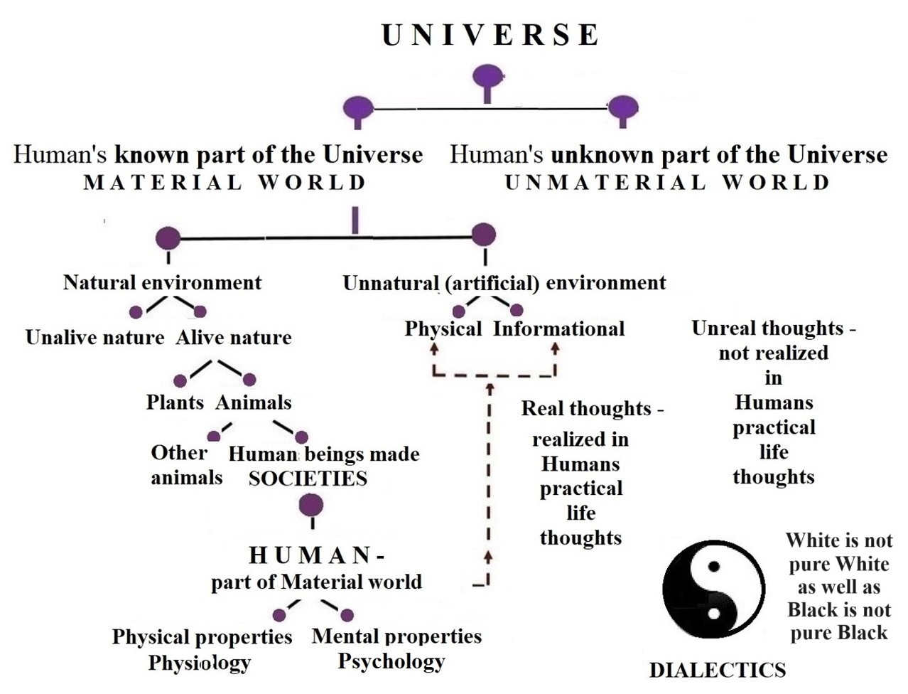
General structure
of the UNIVERSE
UNIVERSE - it is a set
of diverse Phenomena
as Changing Things.
LIFE - it is a set of diverse humans’ activities to satisfy their needs of Life.
It’s continous everyday meeting with something known and unknown!
HUMAN as Homo
Sapiens – it is the conscious alive (living) being.

Slide 6
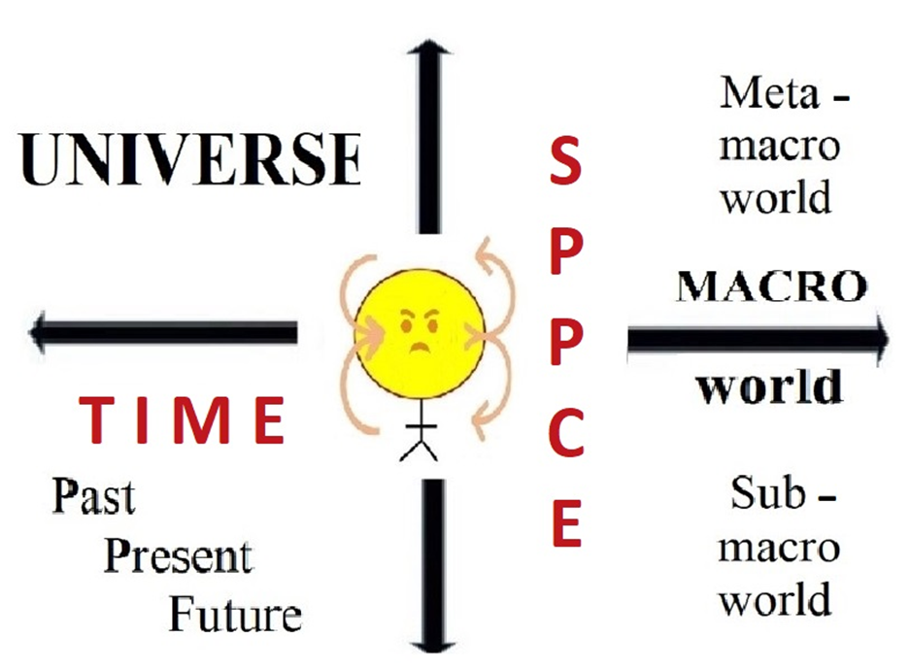
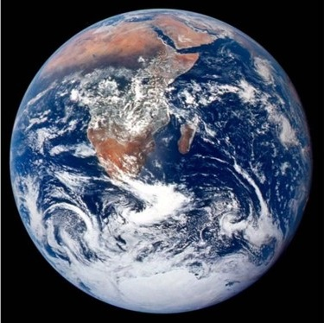
All phenomena of the Universe are represented
in the World of Human’s Thoughts as changing things,
that are interconnected and interacting in Space and Time
SPACE-TIME
CROSS –
the most important
dialectical
Thoughts structure
Me as a HUMAN - part of the Universe: here (in space) and now (in time)

Slide 7
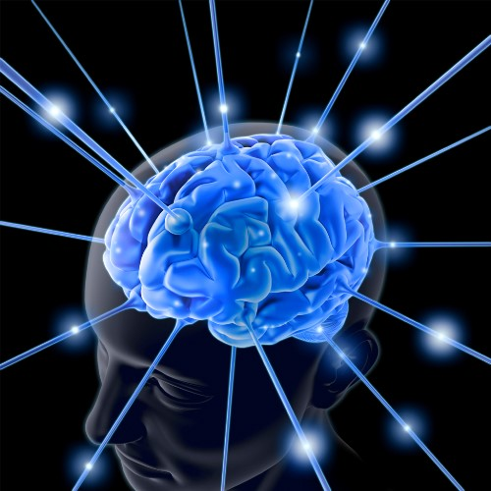
Humans perceive and describe the UNIVERSE
(as a diverse set of phenomena as changing things)
by PARTS, comparing them with each other
and connecting them into the WHOLE as the SYSTEM.
Observed in practice
cause-and-effect chain
relationships of the phenomena within the Universr are explained
as INTERACTION of all Things – phenomena of
the Universe.

Slide 8
U N I V E R S E as the S Y S T E M
All phenomena
of the Universe – (every thing as a changing thing in space and time)
I N T E R A C T S
with every
other
Thing else.

Slide 9
I N T E R A C T I O N of everything within the Universe
is one of the top level concepts of all systems theories
The process of interaction of things means mutual action (influence) and corresponding reaction (counterinfluence) of things. Mutual actions and reactions of interacting things are represented within the Human's World of Thoughts as PROCESSUAL SYSTEMS.
Observing things in practice, it is found that the reaction (effect) lags behind the cause in time. Modern theories today succesfully explain this very important for practice effect-and-cause chain relationship.
FORCE, WORK, ENERGY, POWER
as well as Statics and Kinetics, Dynamics and Energetics, transformation, transmission and storing of energy today are well developed general concepts for practice.

Slide 10
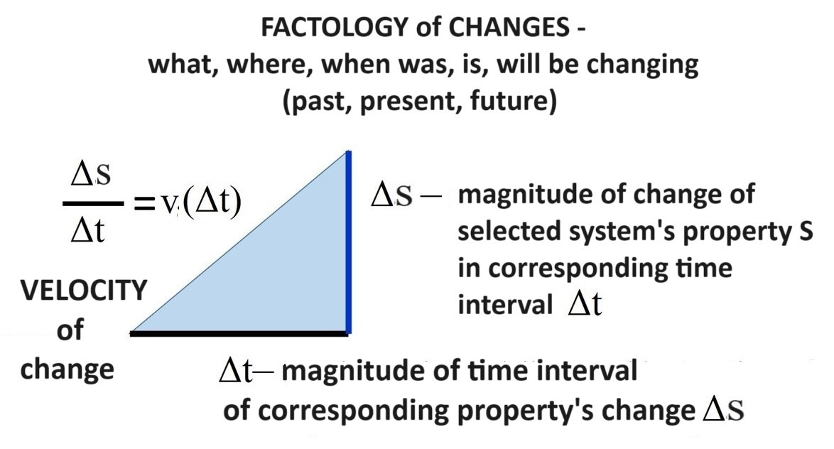
Understanding and comprehension of every CHANGE OF SYSTEMS properties as a causal process is based on the concept of VELOCITY what connects two other fundamental concepts of
SPACE and TIME.
CHANGES OF VELOCITY are because of active summary FORCE
of corresponding systems interaction

Slide 11
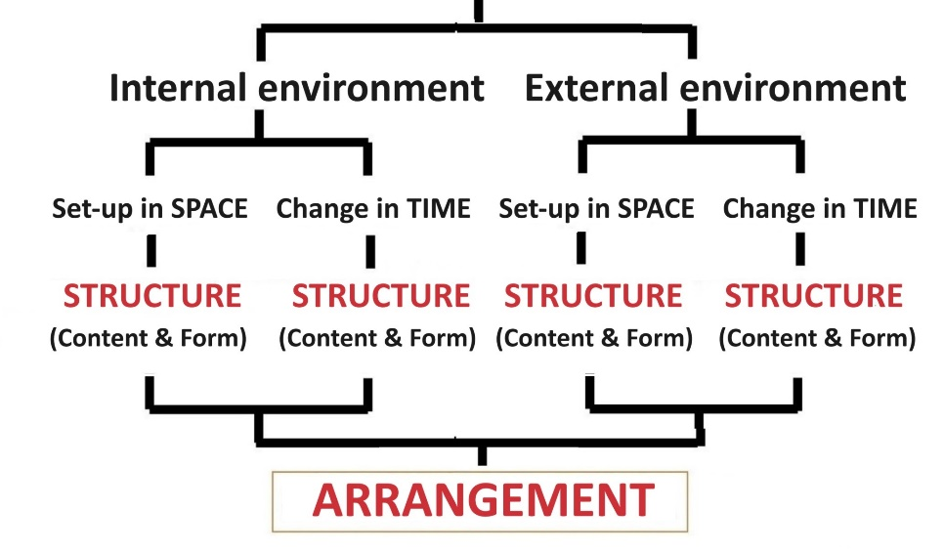
During the study of 2nd chapter of the 3rd part
of the course, we will causally consider
three Great Thoughts about Human’s Life in Society
HUMAN L I F E SOCIETY
Week no 9 Week No10 Week No 11
Cause ------------------- Effect - Cause-----------------Effect

Slide 12
Let’s continue
our distance meeting -
stage No2
Now it is last time to send QUESTIONS
for interactive SEMINAR,
what follows just after this
LECTURE

Slide 13
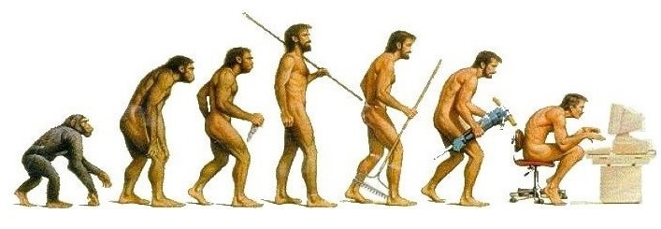
What are your QUESTIONS, SUGGESTIONS?
Please write them in the "chat" section of computer-based communication - we will discuss them after the lecture!

Slide 14
We are thinking Big Thoughts about Human’s LIFE!
Ask these questions
to yourself :
Who I am? What person I am?
Who and what PERSON do I want to be?
How should I LIVE so that MYSELF and OTHER people are satisfied with my LIFE?

Slide 15
Let’s continue
our distance meeting -
stage No3
3rd chapter of the 3rd part
of the study course:
Human’s LIFE as the SYSTEM

Slide 16
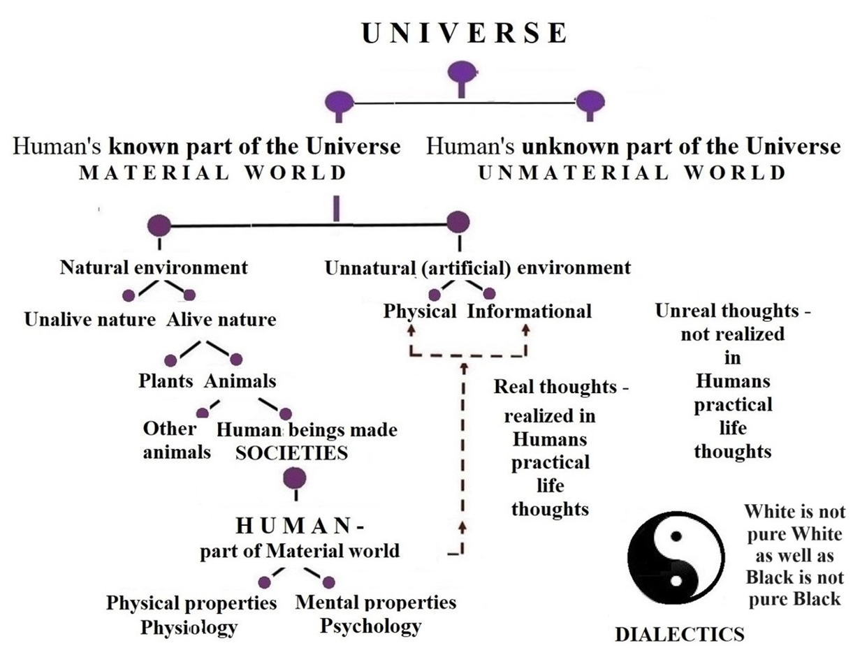
HUMAN – conscious alive being, what is a part of the Universe – subsystem of the Universe as the SYSTEM

Slide 17
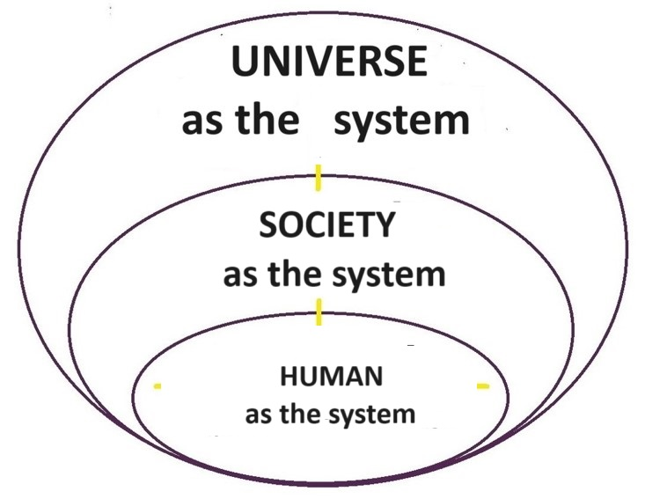
HUMAN’S LIFE as the subSYSTEM fits into the total hierarchical structure of the UNIVERSE as the SYSTEM
Every HUMAN as the WHOLE (SYSTEM) is PART (subSYSTEM)
of the MACRO world within the UNIVERSE!
I am a part of the Universe : here in SPACE and now in TIME.

Slide 18
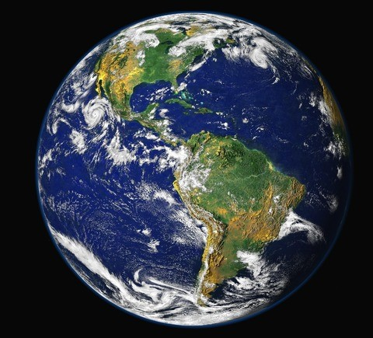
What does it mean «human is alive being?
Human as alive being exists as a part of the Universe –
E X I S T A N C E of human being in SPACE and TIME –
it means HUMAN’S LIFE on the Earth
Each living person is characterized by the coexistence of four processes - internal and external circulation on substance and information.
Diverse circulations | Substance | Information
Internal | * | *
External | * | *

Slide 19
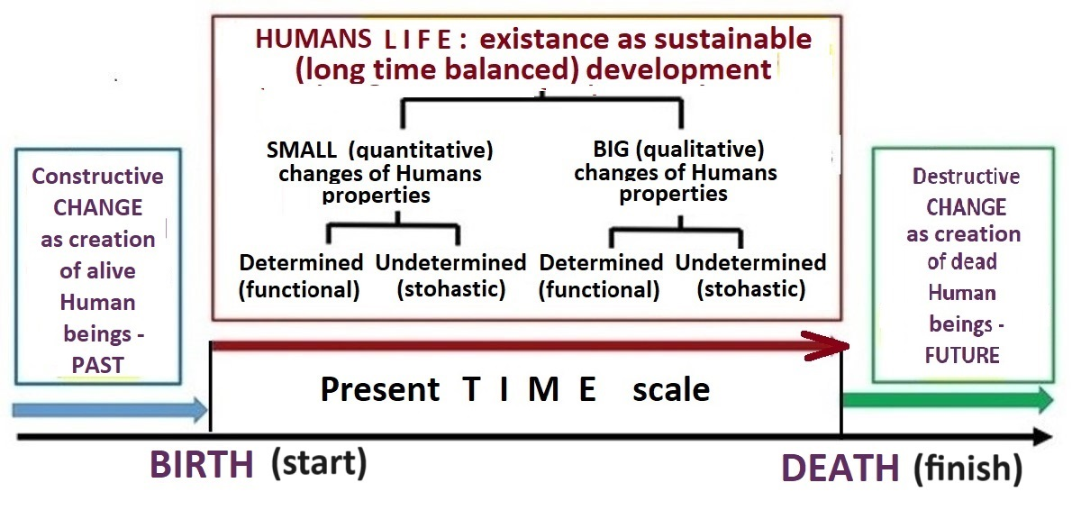
E X I S T A N C E of the H U M A N I T Y on the planet EARTH –
sustainable (long time balanced) development of Humans LIFE

Slide 20
WORLD of THOUGTS –
REPRESENTATION of reflected phenomena of the UNIVERSE
THOUGHTS – representations of reflected phenomena of the UNIVERSE, what are embodied in the human’s brain concepts and images, which are characterized by the corresponding words.
THINKING – it’s arranged processing – arranging of all thoughts within human’s brain, what ensures the management and execution of more or less consciously organized human’s life activities.

Slide 21
T H I N K I N G - creation and processing of THOUGHTS
CONSIDERATION
The external
TRANSMISSION
of thoughts
and the
REALIZATION
of real thoughts
in practice
* description of sensations
* coding of sensations (signs)
* sensing (seeing, hiearing, touching)
SENSES
(communication
and observation)
COGNITION A C T I O N
M a t e r i a l w o r l d – known to Human part of the Universe - – Human’s real living environment

Slide 23
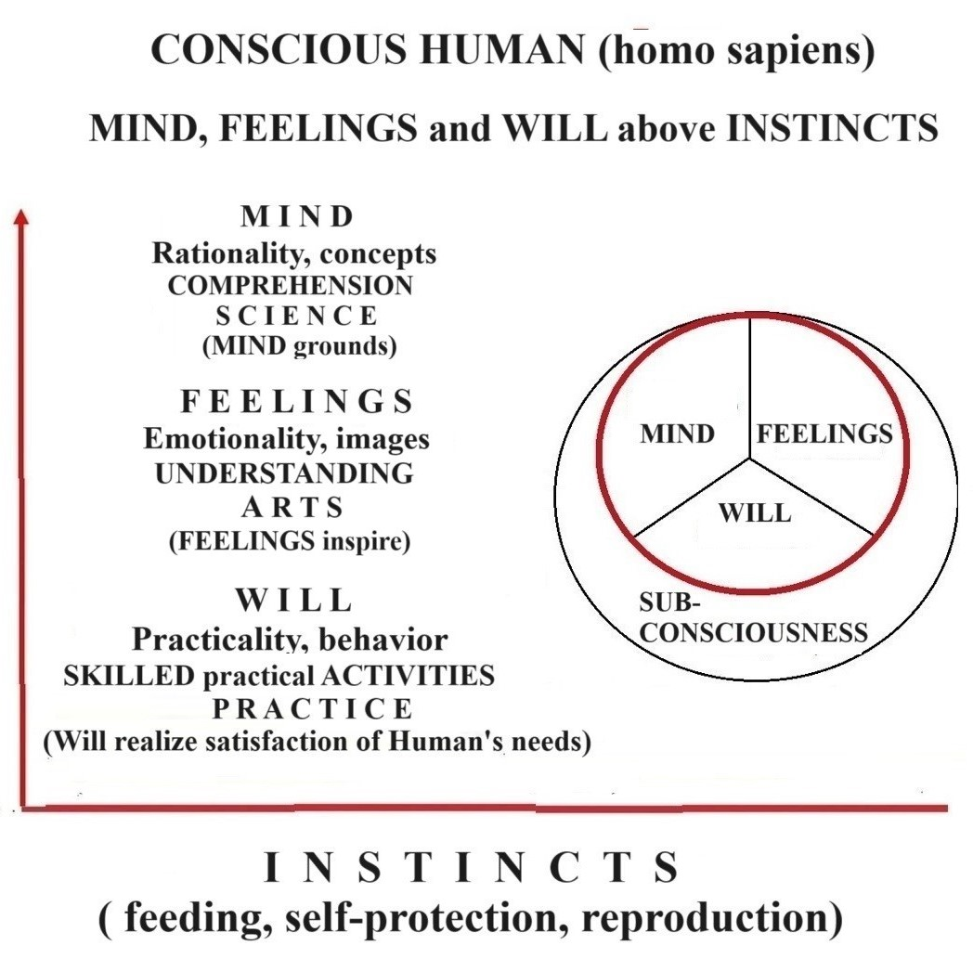
HUMAN’S I N T E L I G E N C E
EMOTIONAL INTELLIGENCE is one of the characteristics of human’s consciousness (spirituality, mentality)), which is related to a person's emotionally imaginative world of feelings. However, the emotional manifestation of feelings is only one part of the human’s consciousnessy in the real practice of our life.
RATIONAL INTELLIGENCE is the top part of human’s consciousness that complements emotional intelligence. Rationality ensures the purposeful realization of created by the human’s mind scientific knowledge.
Finally, the third part of spirituality exists at the level of human consciousness. It is the WILL (willpover) without which the human’s INTELLIGENCE does not create comccious human’s life as the whole.

Slide 24
Human’s LIFE wihin the Universe
in space and time – processual system
Human’s LIFE | Physical LIFE (physiology) |  | Mental or psychic or spiritual LIFE (psychology).
External environment | s(t) Step by step | s(t) Step by step | s(t) Step by step | s(t) Step by step
Internal environment | s(t) Step by step | s(t) Step by step | s(t) Step by step | s(t) Step by step
 | SPACE (s) | TIME (t) | SPACE (s) | TIME (t)

Slide 25
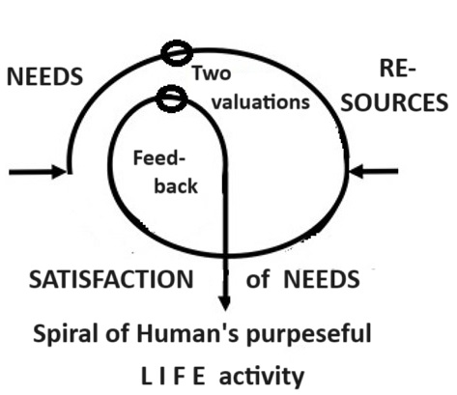
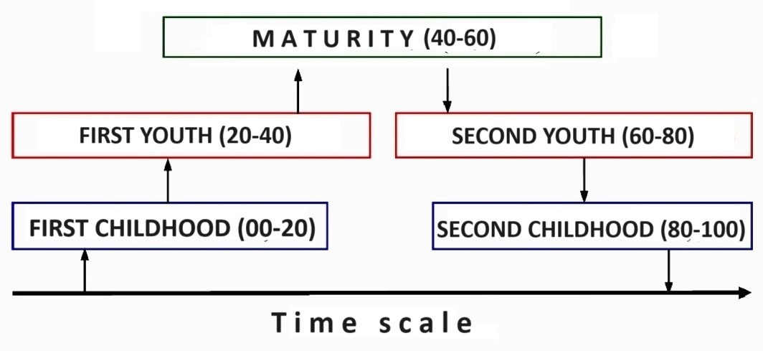
Human’s LIFE is a SET of diverse HUMAN ACTIVITIES - a processual SYSTEM that characterizes a continous more or less conscious process
of satisfying the needs of Human’s life.
The characteristic periods of a person's life cycle
VALUE ORIENTATION of the person is the main indicator of the direction of the conscious Life, which, in turn, is based on the VALUES WHAT HUMAN BELIEVE!

Slide 26
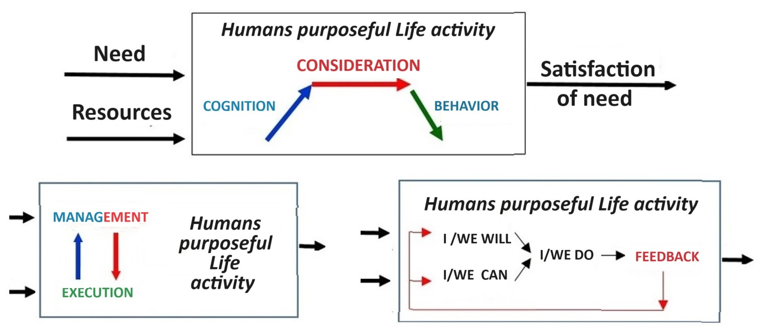
Three mutually complementary Thought (mind) maps visualize the structure of every purposeful human activity as processual system
If i have a need, then I cognize (study) this need, consider possible activity and
act to satisfy this need within the limits of my actual abilities and possibilities.

Slide 27
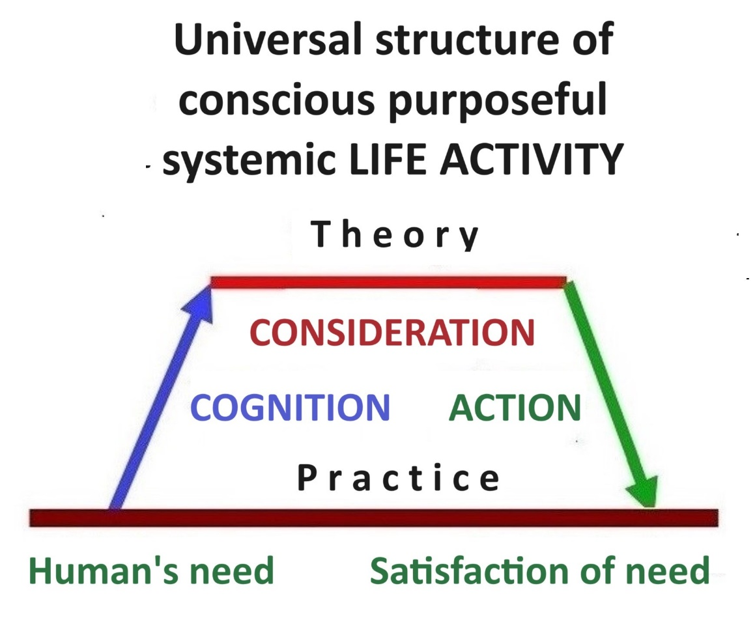
Universal systemic structures
of purposeful human activity

Slide 28
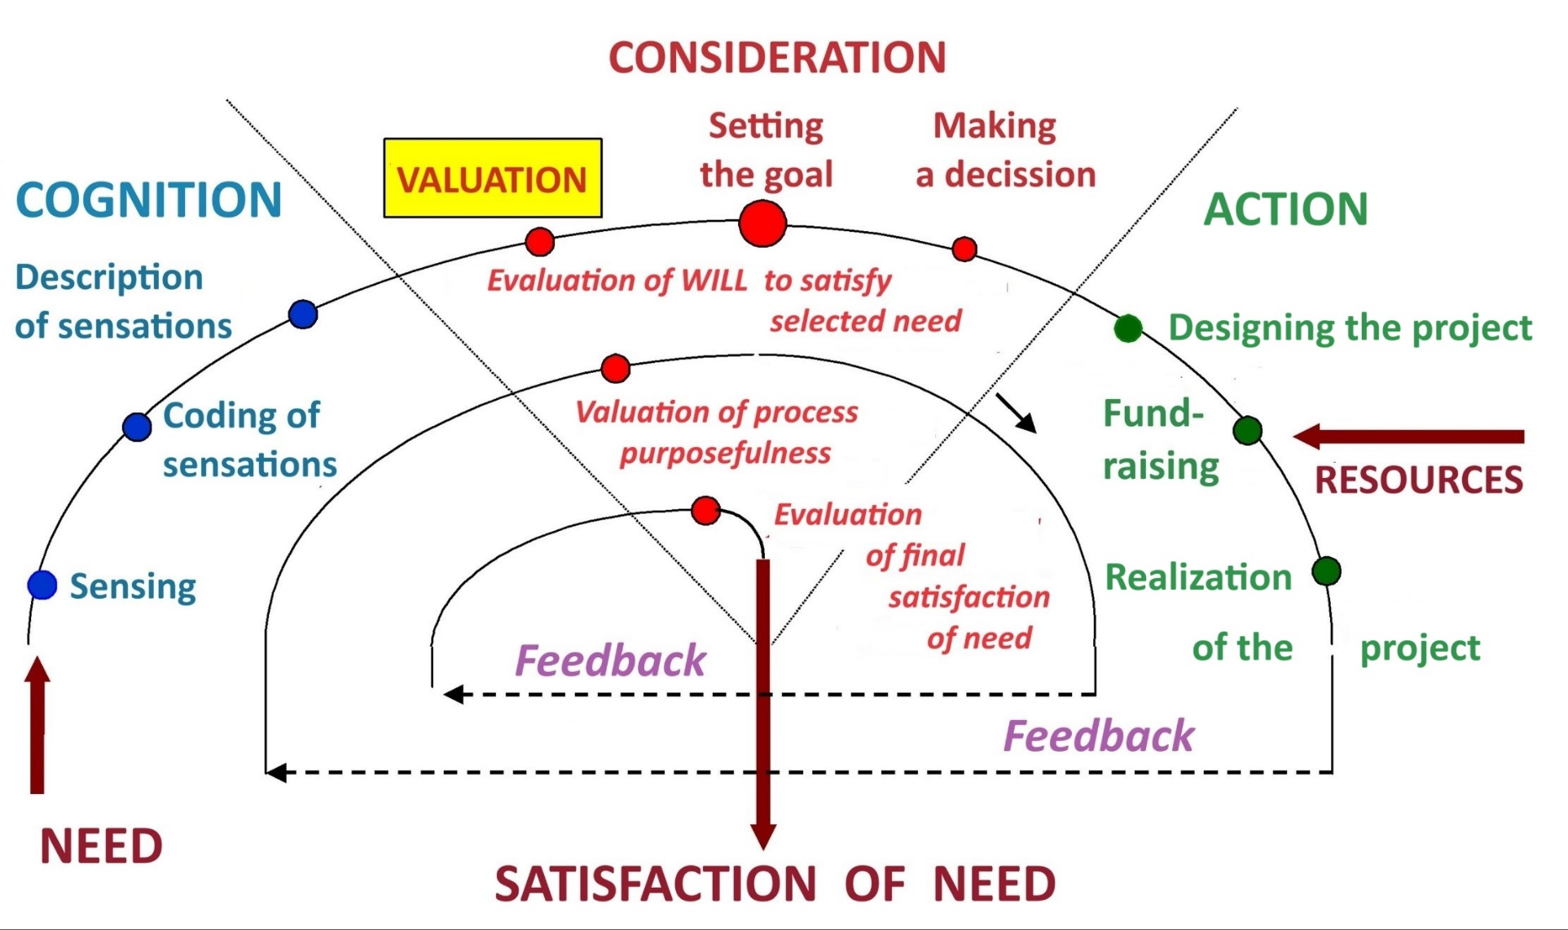
Systemic structure of purposeful human activities –
DIALECTIC OF INTERACTIVE MANAGEMENT AND EXECUTION PROCESSES
M A N A G E M E N T E X E C U T I O N

Slide 29
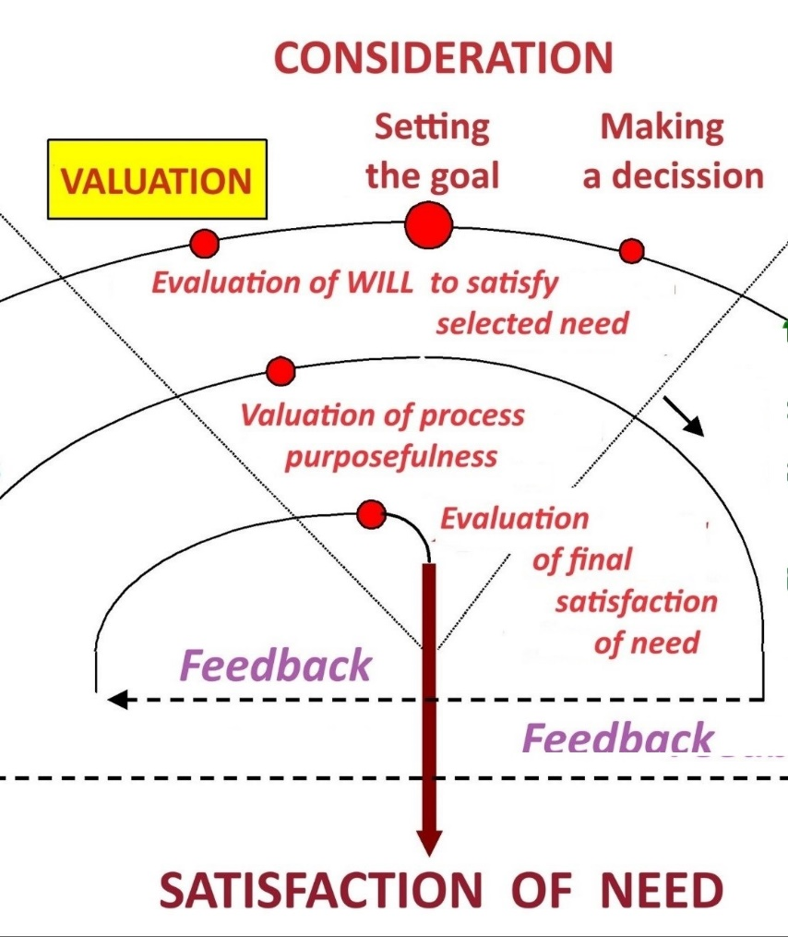
During the realization of purposeful human activities there are at least three consecutive valuations
1) valuation of selected need, determination of will (motivation) to satisfy this need;
2) valuation of the progress of purposeful realization of the project (feedback) ;
3) final valuation of the satisfaction of need.
VALUATION is the process of thinking - determining the value of something, comparing it with a value standard

Slide 30
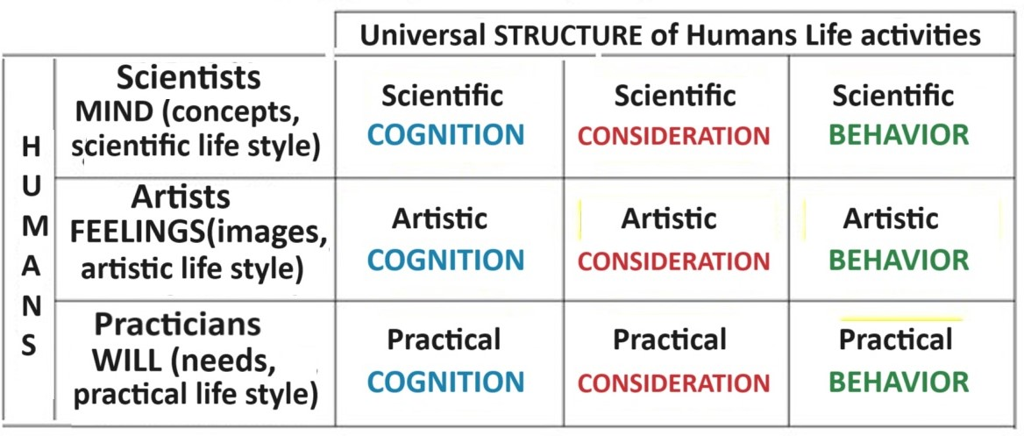
Interconnection of conscious Human’s basic Life styles
and universal structure of Human’s purposeful Life activities

Slide 31
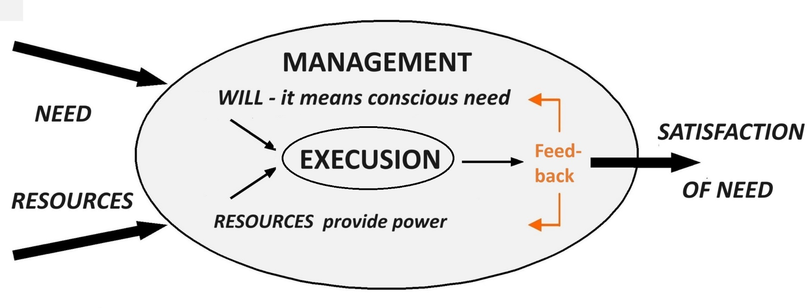
The highest P L E A S U R E is when human’s activity has an exceptionally successful progress to achieve the set goal - to satisfy the need.
The highest S A T I S F A C T I O N is when human has exceptionally succesfully achieved the goal – what means a satisfied need

Slide 32
Successful LIFE gives PLEASURE and SATISFACTION!
The highest P L E A S U R E is when human activity has an exceptionally successful progress to achieve the set goal - to satisfy the need.
The highest S A T I S F A C T I O N is when human has exceptionally great success achieved the goal – what means a satisfied need
L O V E is the highest level feeling of of the highest pleasure
in the process of satisfying a need!
H A P P I N E S S is the highest level feeling of satisfaction
after achieving the goal!
How did you enjoy participating in lecture that just took place?
What is your satisfaction at the end of the lecture?

Slide 33
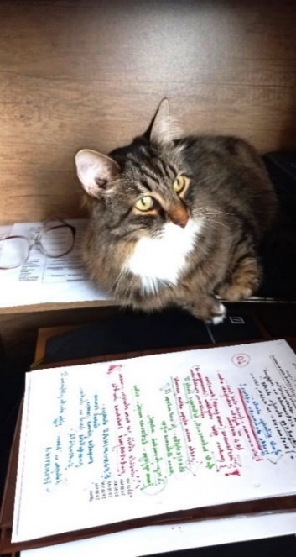
Let me wish
to all of you successful independently creative study week No 10
Materials for study week No9 10_ST(2)23-24 engl 19.04.24
are here: https://failiem.lv/u/qzqud7k29n
See you again on next Friday, 26.04.24 afternoon (16:30 –18:30)
We continue to study the interconnections between general systems theory and our practical life.
Next topic will be : SOCIETY as the SYSTEM.

